Slide 1
Stochastic Calculus for Finance 2023/08/15

Slide 2


Slide 3



Slide 4



≥0
>0
>0
≥0
≥0

Slide 5
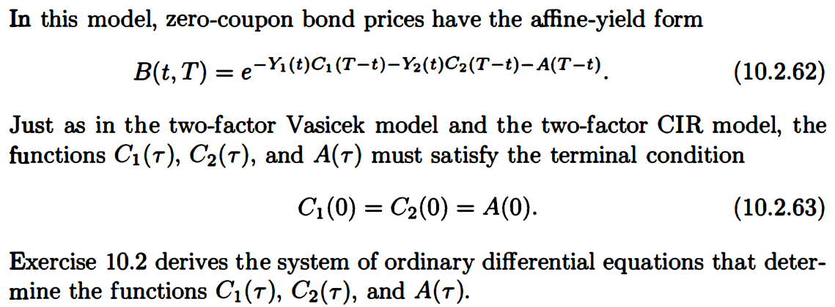

Slide 6
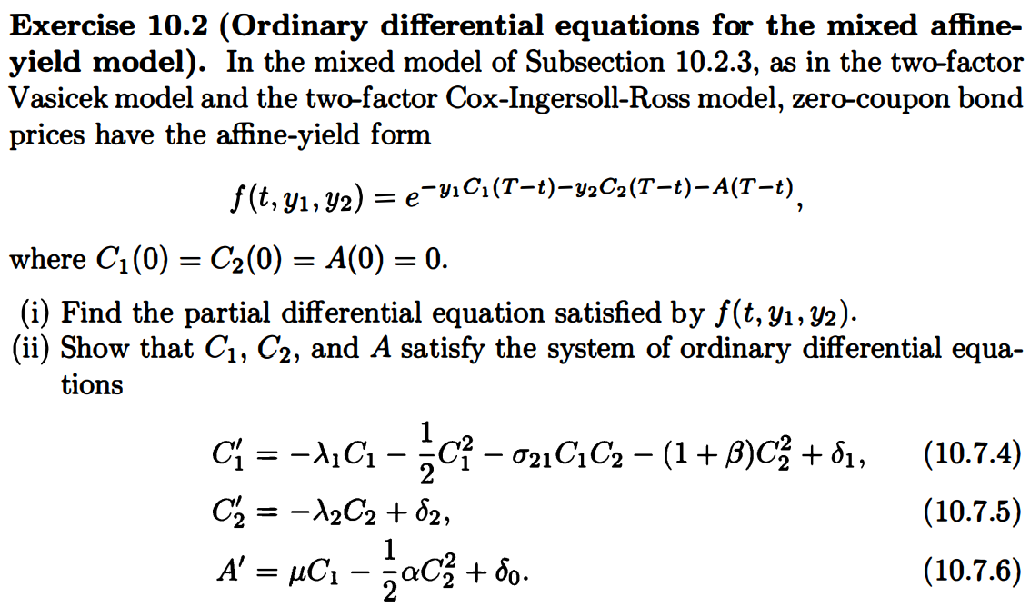

Slide 7





Slide 8
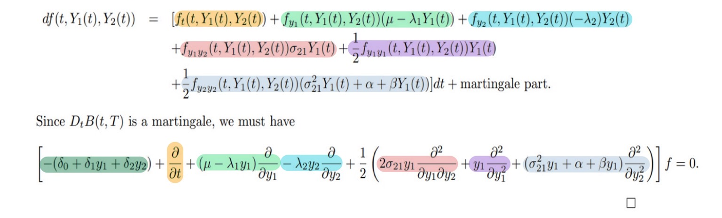

Slide 9
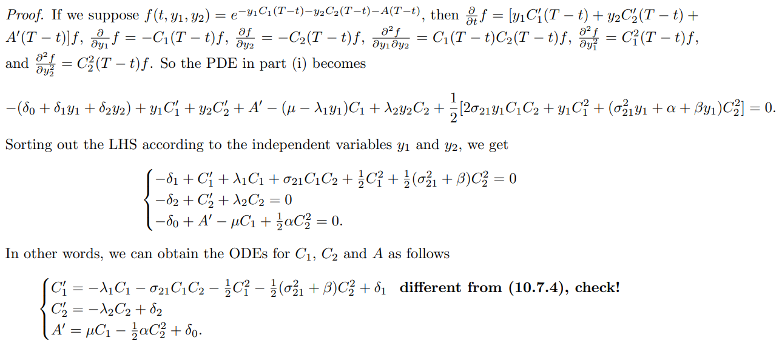

Slide 10


Slide 12


Slide 13


Slide 14
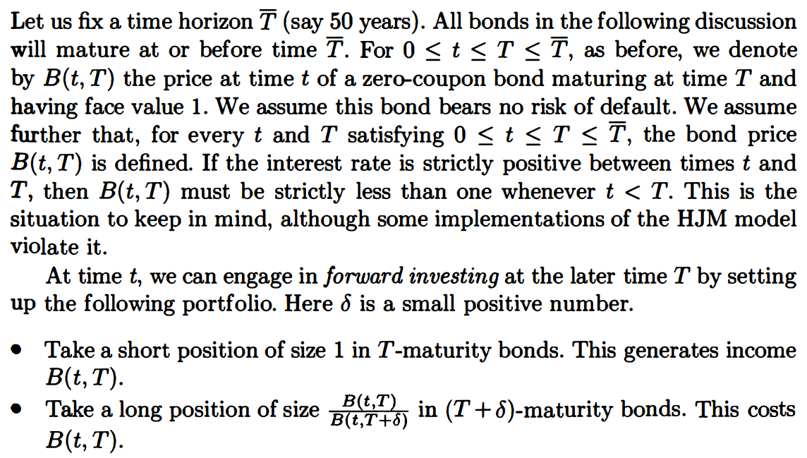


Slide 15
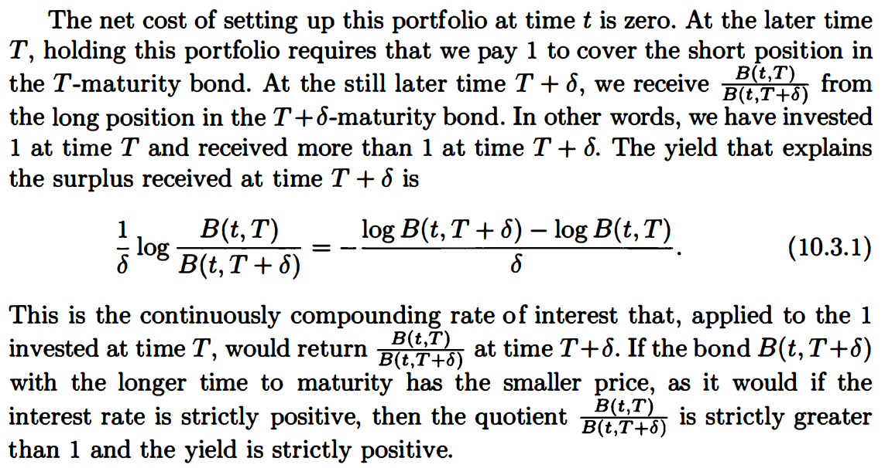


Slide 16
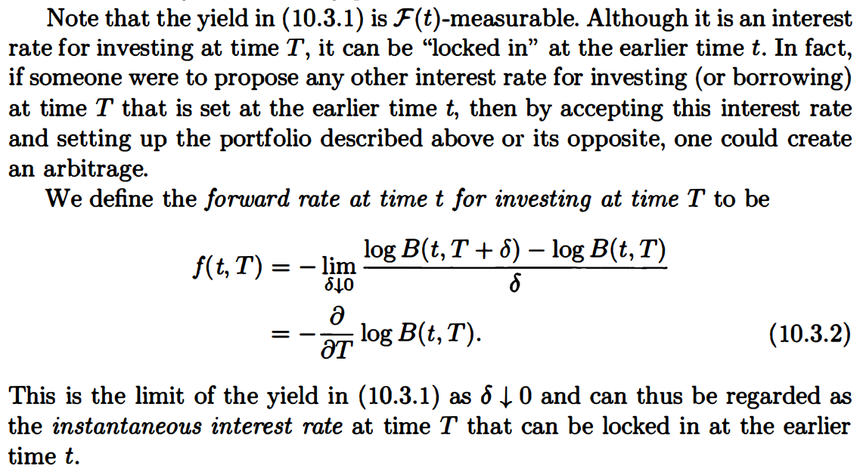

Slide 17
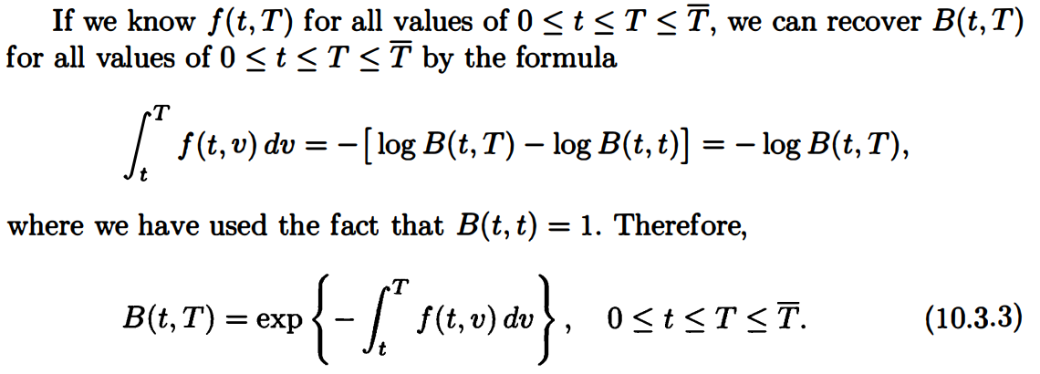

Slide 18
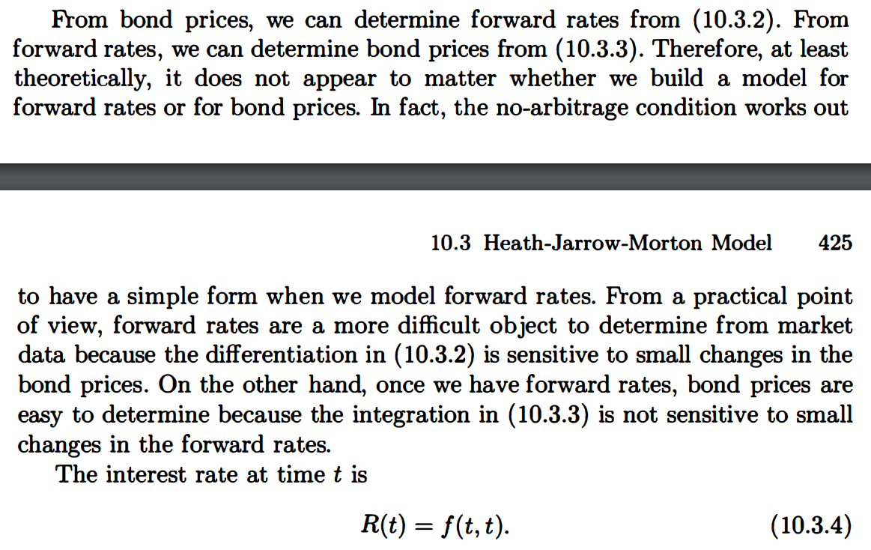

Slide 19
The END

